Slide 1

Employee Attrition Analytics
By: Xinlian Huang
Student ID: 10431624
Instructor: Prof. Mahmoud Daneshmand
Course: MIS637 – Knowledge Discovery Database

Slide 2

OUTLINE
1
Introduction
2
Standard Process: CRISP-DM
3
Conclusion
4
Reference

Slide 3
PART 01
Introduction

Slide 4
Introduction
Human resource is always an essential component in almost every industry, reducing the employee attrition would effectively bring a sustainability and also improve the working atmosphere. There is a company who wants to find out why some of their best and most experienced employees are leaving prematurely. Furthermore, the company also wishes to predict which valuable employees will leave next. So this project aims at assisting the company in reducing the employee attrition and also extract insights from analysis.

Slide 5
Business Understanding
Data Understanding
PART 02
Data Preparation
Standard Process:
CRISP-DM
Modeling
Evaluation
Deployment

Slide 6
2.1
Business Understanding
Profound Questions
Goal
Accomplishments
Why some of the best and experienced employees are leaving prematurely?
How to predict which valuable employees will leave next?
Provide the company some insights on employee attrition, the classification goal is to predict whether a employee will leave the company or not.
By using this model, help the company recognize whether an employee will leave or not, assist the company in minimizing employee attrition.

Slide 7
2.2
Data Understanding
1. Satisfication_level:
Scaled in 0-1, the bigger the number is, the more satisfied the employee feel about the job.
2. Last_evaluation:
Time since last performance evaluation, scaled in 0-1, the bigger the number is, the time since last evaluation is longer
3. Number_project:
Number of project completed while at work
4. Average_montly_hours:
Average monthly hours at workplace
5. Time_spend_company:
Number of years spent at company
6. Work_accident:
Whether the employee had a workplace accident, 0 stands for no, 1 stands for yes
7. Left:
Whether the employee left the company or not, binary variable, 0 stands for still active at company, 1 stands for left the company.
8. Promotion_last_5years:
Whether the employee was promoted in the last five years, 0 stands for no, 1 stands for yes
9. Department:
Department in which they work for
10. Salary:
Relative level of salary (high/medium/low)
Data Source
https://www.kaggle.com/colara/human-resource/data
Dataset Detail
This dataset contain 15,000 records of employee, 11429 employees didn’t leave the company, 3572 employees left the company.
10 attributes in this dataset in total. Out of which 9 are independent variables, 1 is target variable.
Attribute Detail

Slide 8
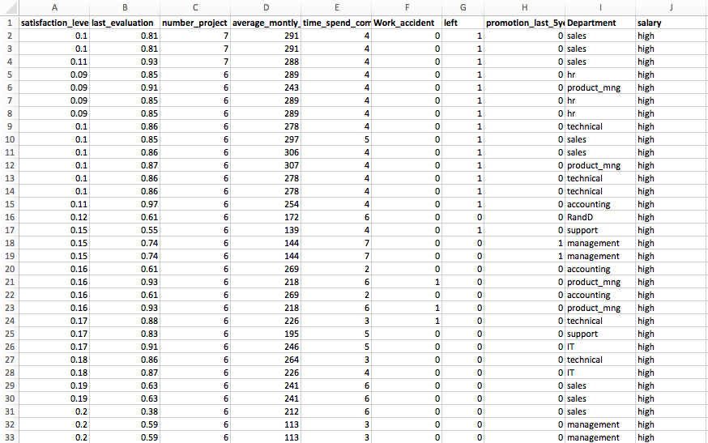
2.2
Data Understanding
Sample Data

Slide 9

2.3
Data Preparation
Handle missing values & Identify outliers:
Attribute selection: select attributes appropriate for analysis:
There is no missing values.
According to the boxplot, no outliers were found in the dataset.
According to the heatmap, all the 10 attributes seem to have great importance in determining the target attribute.
Data division:
Look for attributes that might need transformation:
The whole data contain 15,000 records, which would be split into 2 sets.
Training dataset: 80% (12000) records would be used to develop the model.
Testing dataset: 20% (3000) records would be used to evaluate the model.
Convert the string variables into numeric: in the column ‘Salary’.

Slide 10
2.4
Modeling
The target variable is binary: whether the employee left the company or not. Here I used Decision Tree and Logistic Regression to do the prediction.
CART (Classification and Regression Trees) constructs binary trees using the feature and threshold that yield the largest information gain at each node
Logistic Regression is an appropriate predictive mathod to conduct when the target variable is binary.
ML Algorithms
Decision Tree @ CART
Logistic Regression

Slide 11
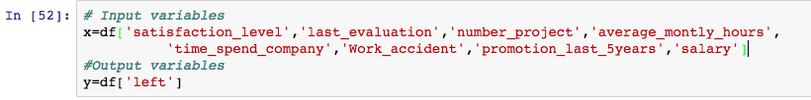
2.4
Modeling
Input & Output Variables
Programming Tool:
Input Variables:
Satisfication_level
Last_evaluation
Number_project
Average_montly_hours
Time_spend_company
Work_accident
Promotion_last_5years
Salary
Output Variables:
Left
Python - Jupyter Notebook

Slide 12
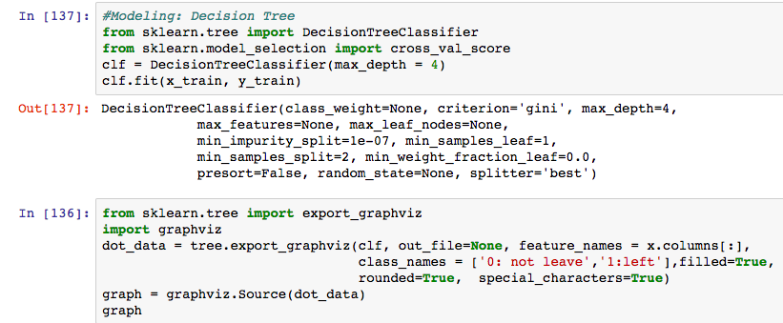
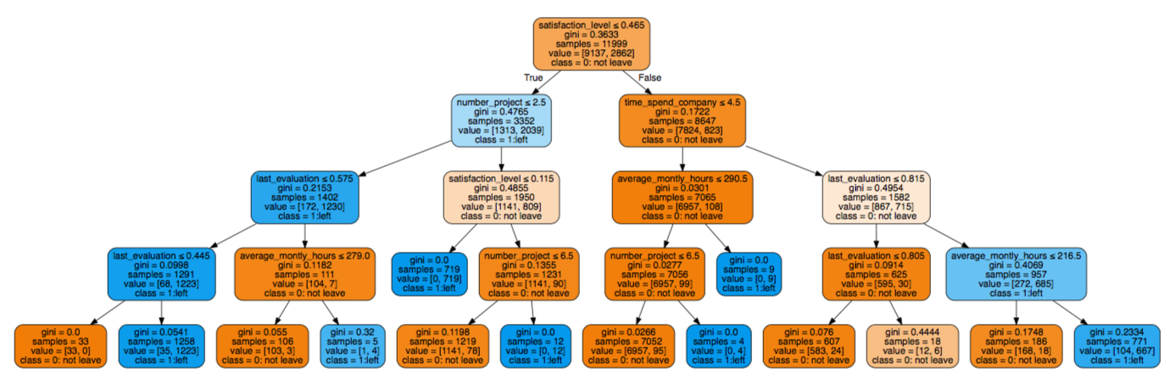
2.4
Modeling
Model 1:
Decision Tree using CART

Slide 13
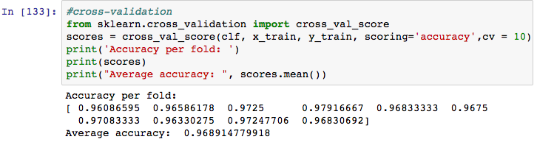
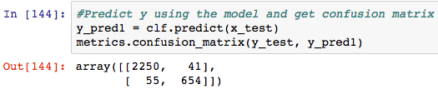

2.4
Modeling
Model 1 : Cross-Validation
Average accuracy is 96.8%, means that 96.8% of the employees are classified correctly.
Testing our model
True Positive = 2250
True Negative = 654
False Positive = 55
False Negative = 41

Slide 14
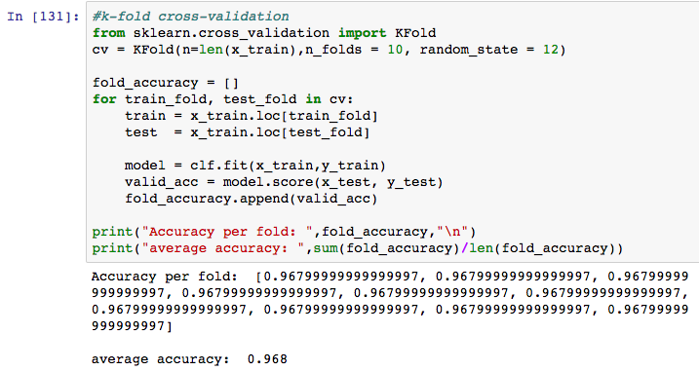
2.4
Modeling
K-fold Cross-Validation
When K = 10, put the training dataset into cross-validation, the average accuracy is 96.8%, means that 96.8% of the employees are classified correctly.

Slide 15
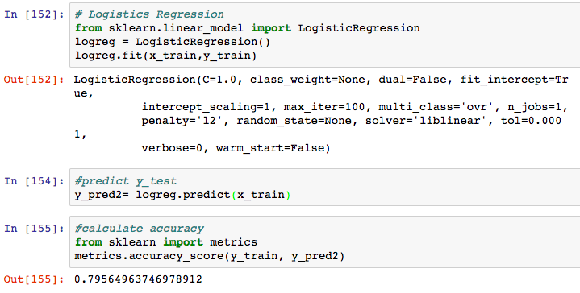
2.4
Modeling
Model 2:
Logistic Regression
Accuracy: 79.56%

Slide 16
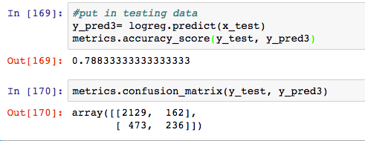
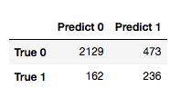
2.4
Modeling
Model 2: Cross-Validation
Accuracy is 78.33%, lower than accuracy of Decision Tree.
Testing our model
True Positive = 2129
True Negative = 236
False Positive = 162
False Negative = 473

Slide 17

2.5
Evaluation
Both of the models have a high prediction accuracy, we were able to make good
predictions on the basis of the key attributes.
Decision Tree has a relative higher prediction accuracy (96.8%) than Logistic Regression (78.3%)

Slide 18
2.6
Deployment
Model could be executed in small dataset at first to ensure the success of model.
Company could utilize this model to minimize the attrition of employee and also make improvement.
Final phase of CRISP-DM process. We can make use of the model and perform deployment.
Predicted results should be compared with the real results in order to verify the accuracy of model.

Slide 19
PART 03
Conclusion

Slide 20
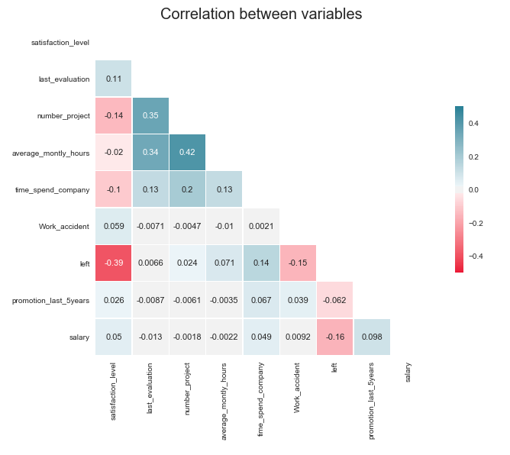

3.1
Conclusion
Why employee left?
According to the heatmap, employees who have a low satisfaction level are more likely to leave the company. Company need to think about why those employees are not satisfied with the job and make corresponding improvements in order to reduce attrition.

Slide 21
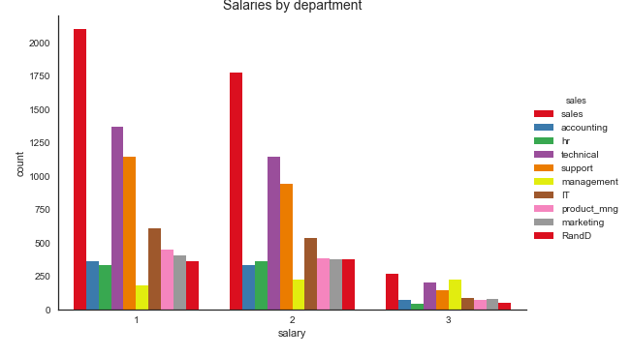
3.2
Conclusion
Who is leaving?
According to the histogram, sales are more likely to leave than other departments in each salary level. That is may because the special commission of sales.

Slide 22
PART 04
References

Slide 23


4.1
References
L
G
K
Lecture Notes & Slides from MIS637
Github.com Example Codes
Kaggle.com
Related Exploratory Data Analysis

Slide 24

THANKYOU

